Slide 1

CloudGaurdian
Category
Engineering Excellence
EXPNGBLHACKFY25Q4
Members
T Gunasekhar
Peesa Ramprasad
17/03/2025

Slide 2
Problem Statement
As a security team, we face significant challenges in monitoring and detecting threats in AWS environments due to several factors.
Firstly, we receive millions of CloudTrail log entries daily, making manual analysis time-consuming and prone to human error. Critical security events can be buried within thousands of benign log entries, making prompt detection difficult.
Secondly, the lack of automated tools for real-time security analysis leads to delays in threat detection. Unauthorized access attempts might not trigger immediate alerts, increasing the risk of data breaches.
Lastly, AWS environments often use multiple services such as EC2, S3, and RDS. Without a unified security monitoring approach, detecting high-risk events across these services becomes challenging.
Coordinated attacks involving multiple services might go unnoticed if each service is monitored in isolation.

Slide 3
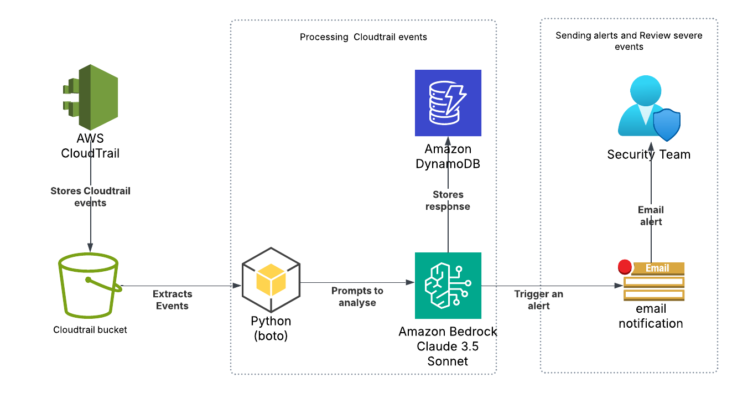
CloudGaurdian

Slide 4
Solution
CloudGuardian offers a comprehensive AI-powered security monitoring solution for AWS environments by addressing key challenges through the following features:
Analysing AWS CloudTrail Logs for Security Risks: CloudGuardian continuously monitors and analyses AWS CloudTrail logs to identify potential security threats. By leveraging advanced AI algorithms, it can detect unusual patterns and behaviors that may indicate security risks.
Using AWS Bedrock’s Claude 3.5 for Automated Threat Scoring: CloudGuardian utilizes AWS Bedrock’s Claude 3.5 to automatically score and prioritize threats based on their severity. This helps us (security team) to focus on the most critical issues first.
Sending Real-Time Alerts via AWS SNS for Critical Incidents: For critical security incidents, CloudGuardian sends real-time alerts through AWS Simple Notification Service (SNS). This ensures that security teams are promptly informed and can take immediate action to mitigate risks.

Slide 5
Benefits
AI-Driven Threat Detection – Automates security event analysis.
Real-time Alerts – Immediate notification of critical risks.
Scalable & Serverless – Fully AWS-native, easily scalable.
Audit & Compliance – All responses stored for future audits

Slide 6
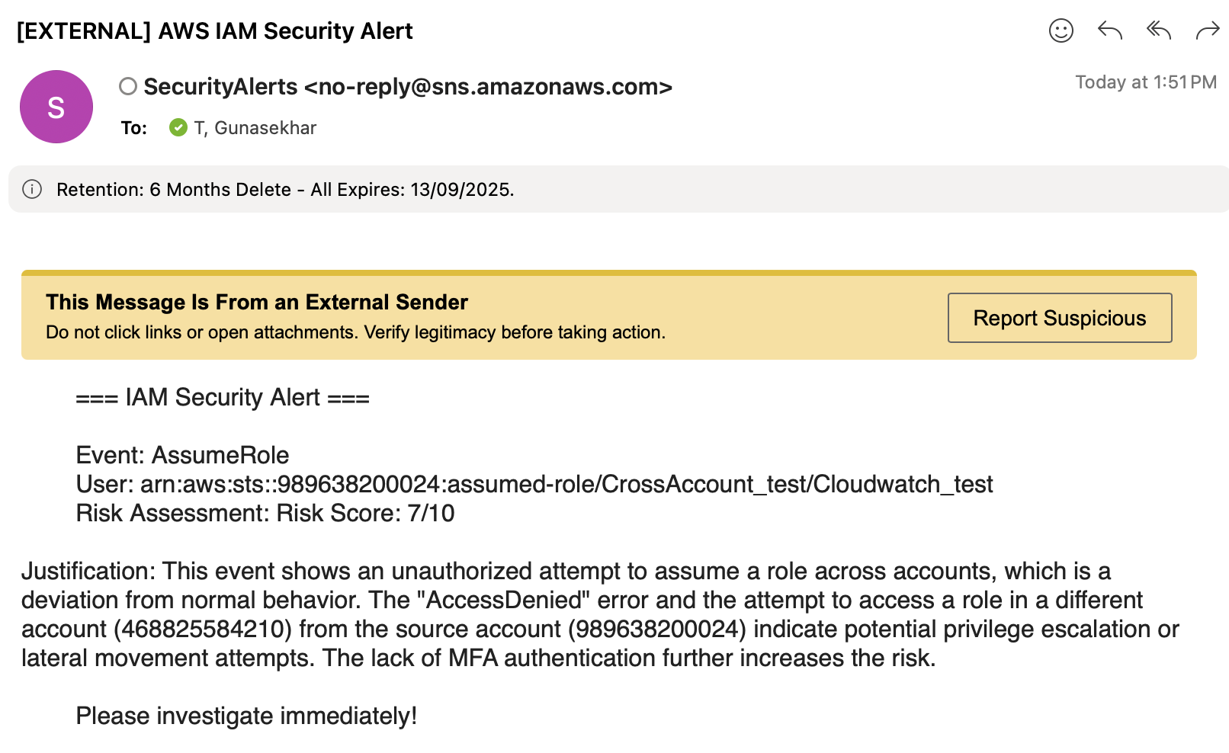
Demo

Slide 7
Resources
Architecture Diagram - Lucid Chart | https://lucid.app/lucidchart/34b8b65a-827e-4d07-9041-48e6cda09f9b/edit?beaconFlowId=02C4F19F1BEEB1E9&invitationId=inv_fbd7eeb9-126d-4b3d-b42f-8dc2d2c0a0f6&page=0_0#
Project’s Bitbucket Repo | https://code.experian.local/projects/CDM/repos/cloudguardian/browse

Slide 8
Thank you!

